Slide 1


EMPLOYEE ATTRITION ANALYSIS
NAME: SNEH PATHAK
STUDENT ID: C0938327
SUJECT: DATA TECHNOLOGY SOLUTIONS
SUBJECT CODE : BDM 1024
PROFESSOR JEY KANESH

Slide 2
Introduction
Employee attrition is a critical challenge for organizations, impacting productivity, team morale, and operational costs. The project focuses on analyzing employee data to understand the underlying reasons behind a company's high attrition rate.
The data-driven approach will enable the company to make informed decisions to reduce the attrition rate, thereby enhancing productivity and reducing financial losses.

Slide 3

BUSINESS PROBLEM
A recently created company is facing an ongoing 16% yearly staff attrition rate. The impact of this high turnover on team morale, productivity, and operating costs is substantial. According to analysis, the expense of replacing an employee results in significant financial losses for the organization since it is roughly 1.5 to 2 times the individual's yearly wage in addition to substantially higher lost productivity. To tackle this problem, we suggest carrying out an analytics investigation. By using a data-driven strategy, the organization will be able to make well-informed decisions that could save money by lowering the attrition rate to under 10% in the upcoming fiscal year.

Slide 4
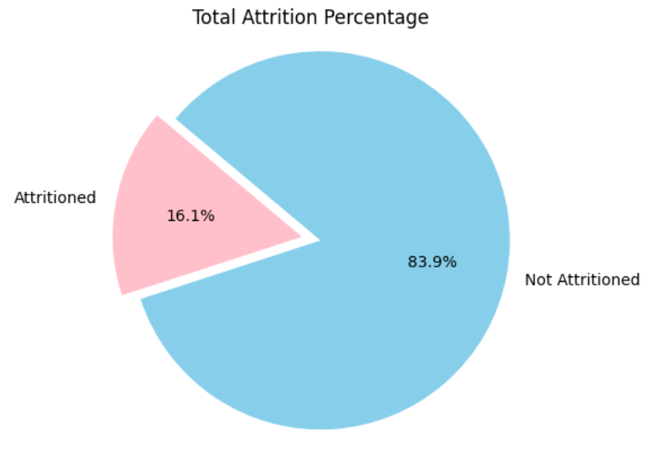
PROJECT STATEMENT
To effectively address the high attrition rate, we need to translate the business problem into a data science problem
statement. This will guide us in generating relevant insights and following appropriate analytical steps.
Attrition Rate: The attrition rate quantifies employee turnover as a percentage. A healthy organization typically has an attrition rate of 10% or less. High attrition negatively impacts the company’s costs, productivity, and morale.
Given our company’s attrition rate above 16%, it is crucial to identify the underlying reasons to develop targeted retention strategies

Slide 5








TOOLS USED

Slide 6
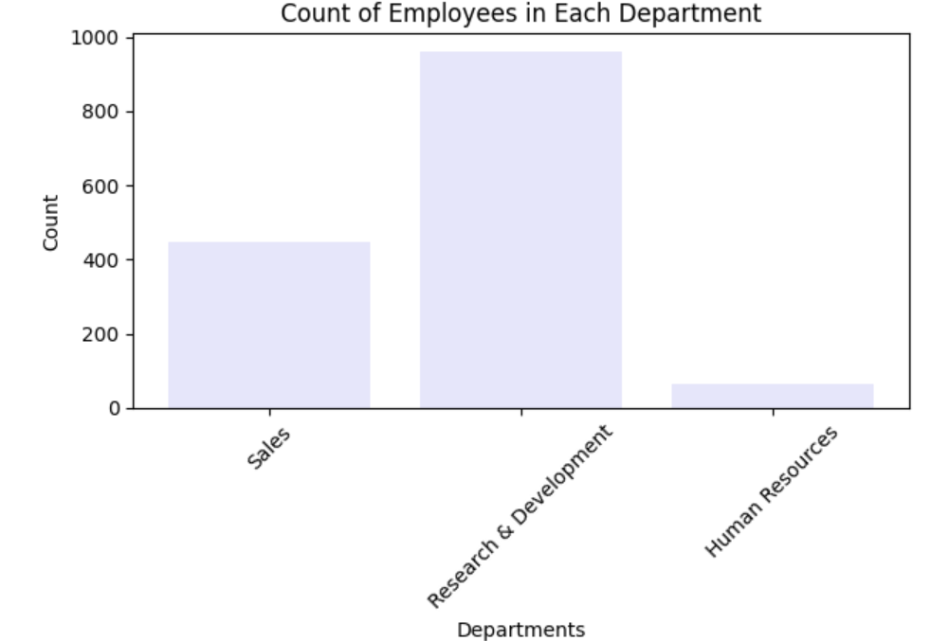
Descriptive Statistics
The distribution across departments shows a concentration in Research & Development with highest number of employees, followed by Sales , and Human Resources.
These insights provide a clear picture of the current workforce demographics and departmental distribution, helping us to better understand the areas most impacted by attrition.

Slide 7
Analysis and Insights
Job Related Factors Includes department, job role, and years with current manager.
To facilitate a comprehensive understanding of the various factors contributing to employee attrition, I have grouped them into several key categories.
These groupings are essential because no single factor can solely account for attrition. By categorizing similar factors, we can gain comprehensive insights into the reasons for attrition and identify areas that require attention.
Demographics
Includes age, gender, and marital status.
Career Progression Includes job level, years since last promotion, and training times last year.
Work Culture
Includes environment satisfaction, job satisfaction, work-life balance, and job involvement.

Slide 8
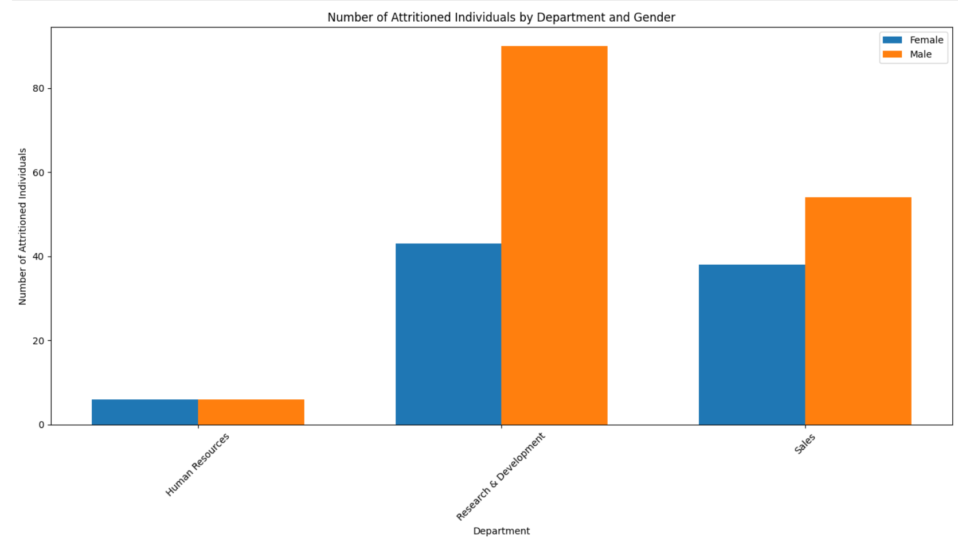
1. DEMOGRAPHICS
GENDER
Gender appears to have a moderate influence on attrition rates, with slightly higher rates observed among male employees. Possible reasons could include varying job roles, career aspirations, or workplace dynamics influenced by gender-specific factors.

Slide 9
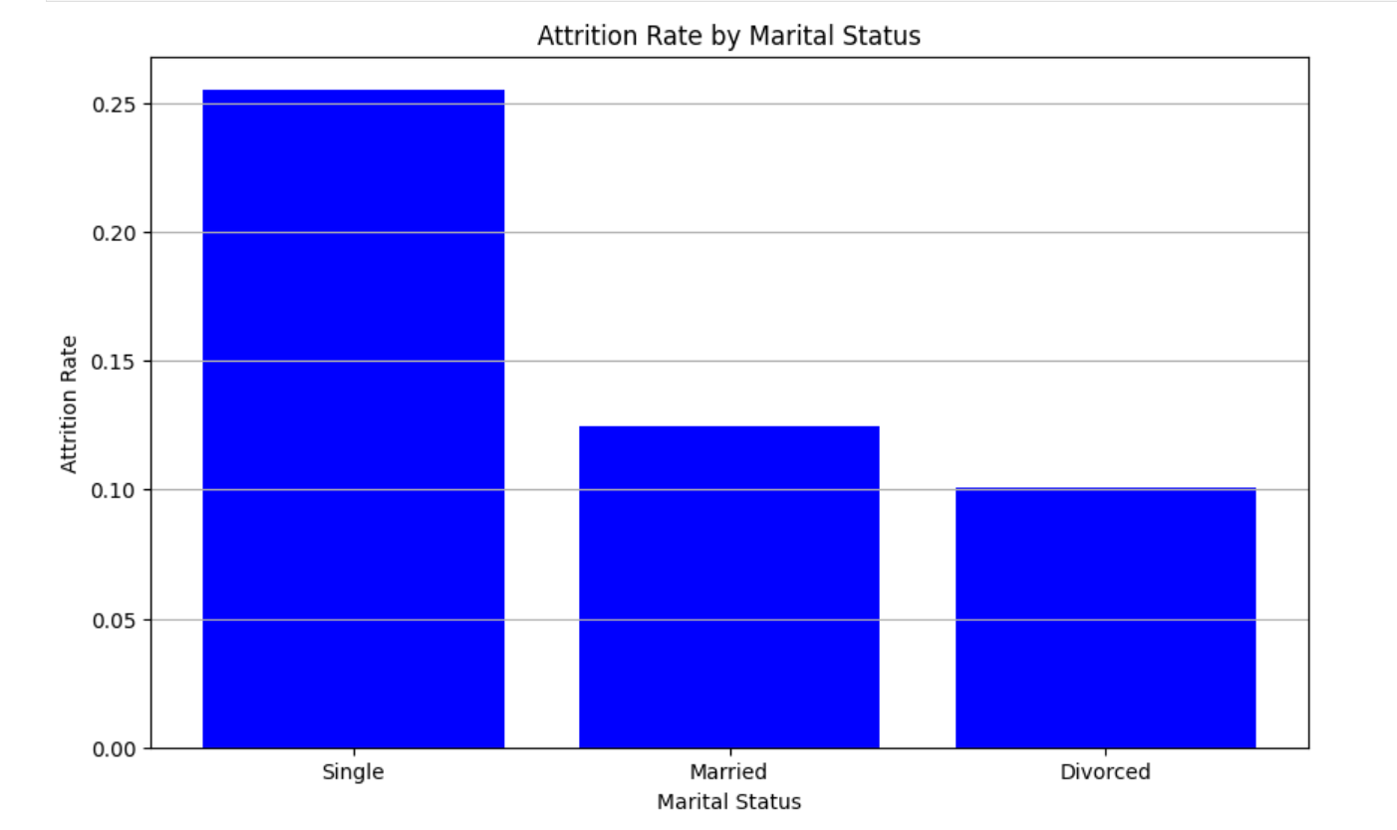
1. DEMOGRAPHICS
MARITAL STATUS
Marital status plays a crucial role in attrition, with single employees showing the highest propensity to leave. This could be due to career mobility, personal life changes, or job dissatisfaction influenced by marital status- related factors.

Slide 10
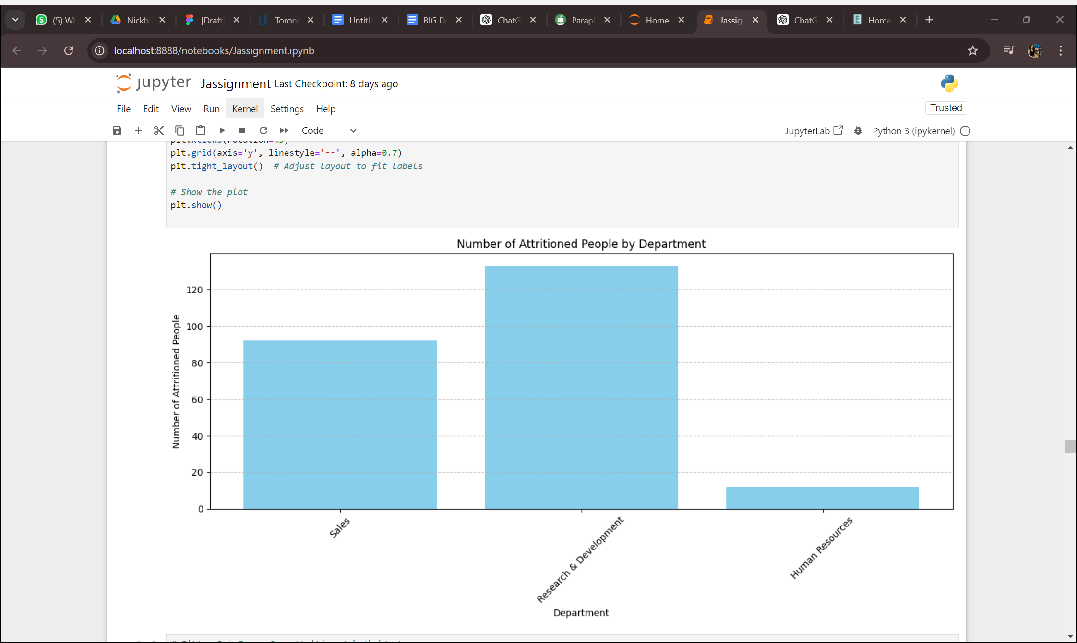
2. JOB RELATED FACTORS
DEPARTMENT
The high attrition rate in Research & Development suggests possible dissatisfaction within this department, perhaps due to job stress, lack of growth opportunities, or insufficient support.
Sales and Human Resources have relatively lower attrition rates but are still significant.

Slide 11
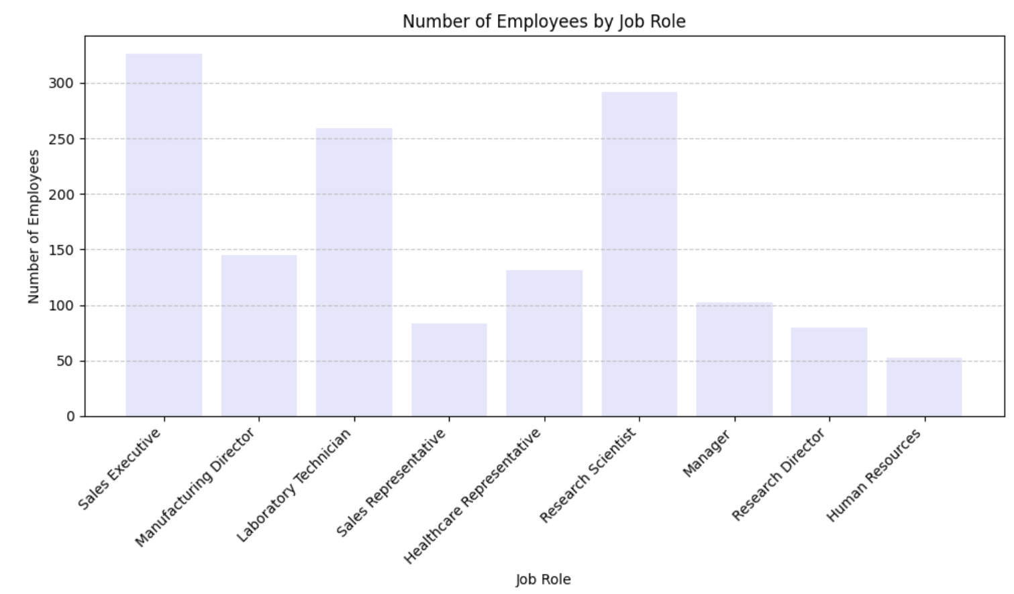
2. JOB RELATED FACTORS
JOB ROLE
The highest attrition rates are among Sales Executive and Research Scientists, indicating potential issues with job satisfaction or career progression in these roles.
Lower attrition rates among Sales Representative and Human Resources suggest better job stability and satisfaction.

Slide 12
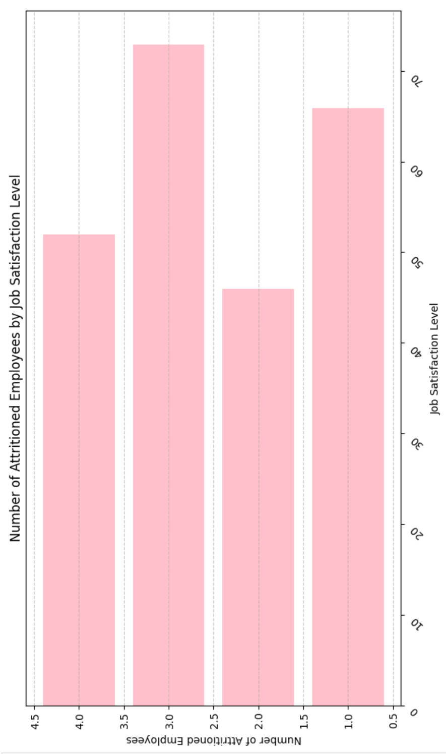
3. WORK CULTURE
JOB SATISFACTION
Employees with the job satisfaction ,rating 3 followed by rating of 1 exhibit the highest attrition rate.
Higher job satisfaction is associated with lower attrition, highlighting the importance of ensuring employees find their roles fulfilling and rewarding.

Slide 13
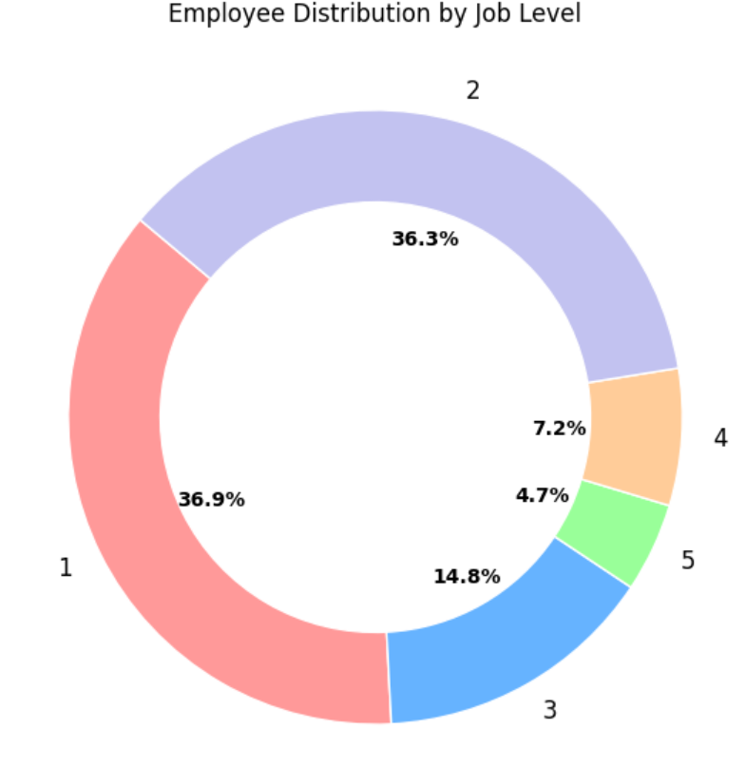
4. CAREER PROGRESSION
JOB LEVEL
Employees at Start-level positions (Job Level 1) exhibit the highest attrition rates. Attrition decreases as job levels increase, with senior- level employees (Job Level 5) having the lowest attrition rates.
This suggests that employees in lower and mid-level positions may feel less secure or less satisfied with their career progression.

Slide 14
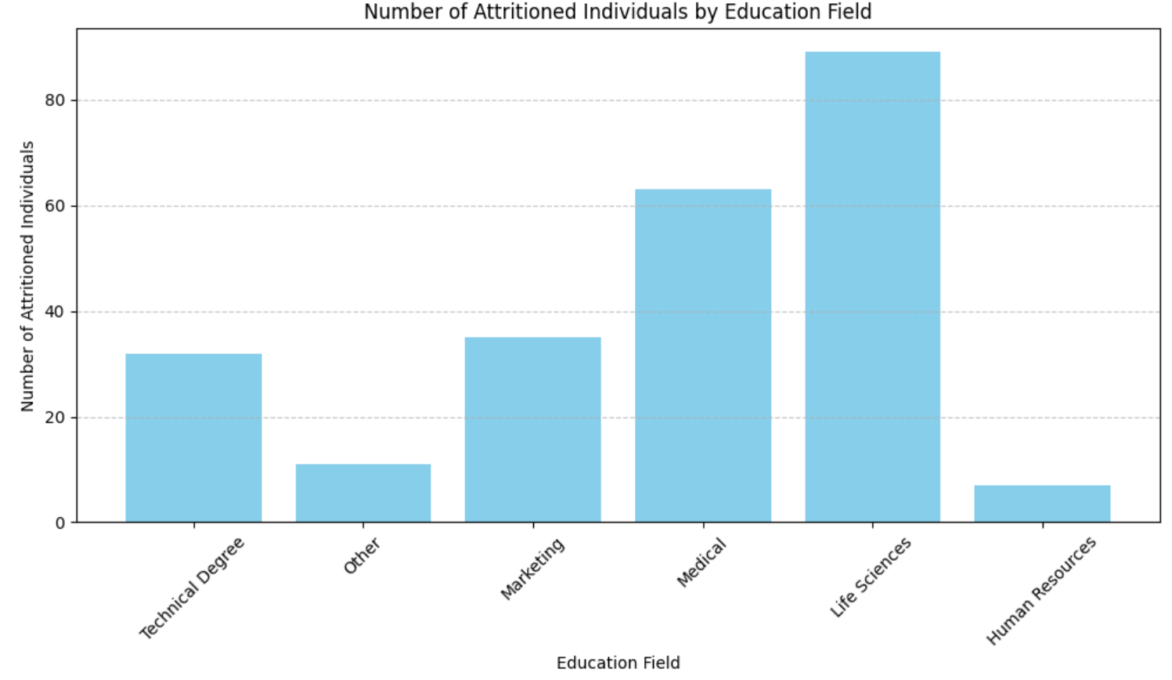
5. EMPLOYEE PORTFOLIO
EDUCATION
Employees with education background in Life Sciences exhibit the highest attrition rates, followed by Medical, Marketing, Technical Degree, Human Resources and others.

Slide 15

LIMITATIONS
Limited Scope: The analysis focuses primarily on internal company data and may not account for external factors such as industry trends, economic conditions, or regional job markets.
Lack of Real-Time Data: The analysis is based on historical data and may not reflect real-time changes or trends that could influence employee behavior and attrition.

Slide 16


RECOMMENDATIONS
Enhance Employee Engagement: Implement programs to improve job satisfaction and work-life balance, especially targeting younger and single employees.
Review Financial Incentives: Offer competitive salary hikes and stock options to retain talent, focusing on those receiving minimal increments.
Support Career Development: Create clear career progression paths and provide regular promotions and training opportunities to boost employee morale.
Improve Work Environment: Foster a positive work culture with a focus on environment satisfaction and job involvement to reduce turnover.

Slide 17

THANK YOUU!!! ☺

